Slide 1

Regression Analysis
Amit Pandey (amitpandeylearn@gmail.com)

Slide 2
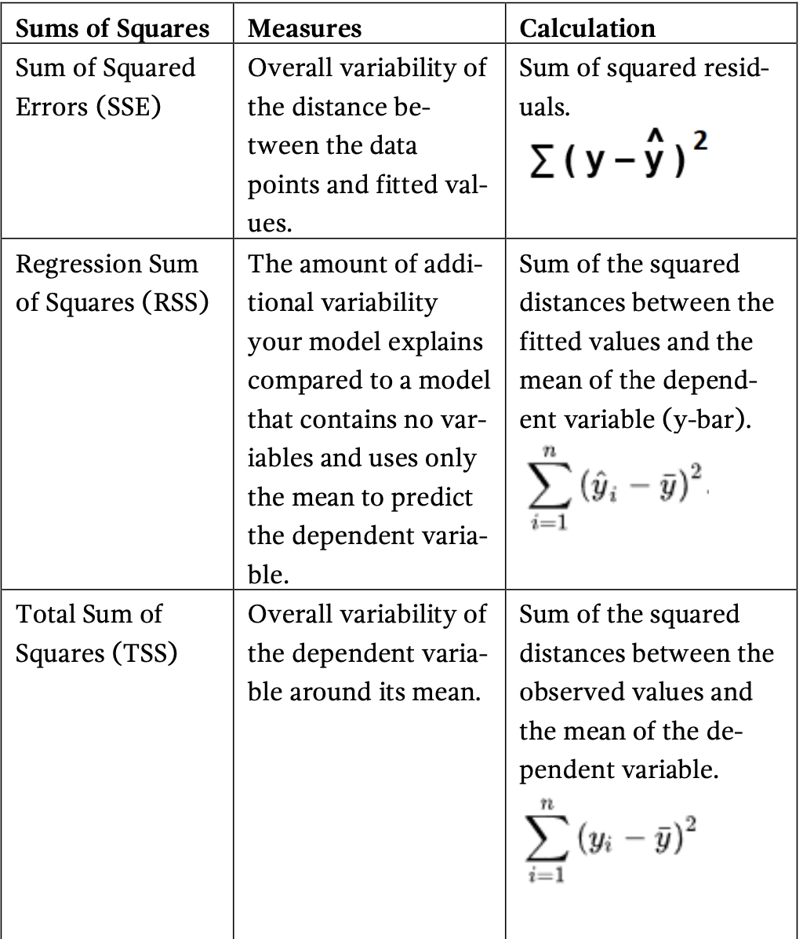

Slide 3
RSS + SSE = TSS
RSS represents the variability that your model explains. Higher is usually good.
SSE represents the variability that your model does not explain. Smaller is usually good.
TSS represents the variability inherent in your dependent variable.
Explained variability + Unexplained variability = Total variability
If you take RSS/TSS, you will obtain the percentage of the variability of the dependent variable around its “mean” that your model explains. This statistic is R-Squared !

Slide 4
R-squared evaluates the scatter of the data points around the fitted regression line. Higher R-squared values present smaller differences between the observed and the fitted data.
Also called – coefficient of (multiple) determination
R-squared is the percentage of the dependent variable variation that a linear model explains
R-squared = Variance explained by the model/ Total Variance
R-squared is always between 0% and 100%.
The larger the R-squared, the better the regression model fits your observations.

Slide 5
Standard error of regression (standard error of the estimate)
The standard error of regression provides the absolute measure of the typical distance that the data points fall from the regression line. SE is in the units of the dependent variable.
R-squared provides the relative measure of the percentage of the dependent variable variance that the model explains.
SE tells you straight-forward how precise the model’s prediction are using the units of the dependent variable. The statistic indicates how far the data points are from the regression line on an average. You want a lower value of SE because it signifies that the distance between the data points and the fitted value are smaller. (whereas in R-squared explain percentage of variance, it does not tell you how far the data points are from the regression line.)

Slide 6
F-test of overall significance indicates whether your regression model provides a better fit to the data than a model which contains no independent variable.
The overall F-test compares the model that you specific to the model with no independent variable (intercept only model)
Two hypothesis
Null Hypothesis – model with no independent variables fit the data as well as your model.
Alternative Hypothesis – model fits the data better than the intercept-only model.
Compare the p-value for the F-test to your significance level. If p-value is less than significance level, you would go with Alternative Hypothesis.

Slide 7
Heteroscedasticity means unequal scatter. It is in context of residual or error term
It is a systematic change in the spread of residuals over the range of measured values.
Problem – because OLS assume all residuals are drawn from a population that has a constant variance.
To satisfy the regression assumption and to be able to trust results, the residuals should have a constant variance.
While heteroscedasticity does not cause bias in the coefficient estimates, it makes them less precise. Lower precision increases the likelihood that coefficient estimates are further from the correct population value.

Slide 8
Multicollinearity causes two problems –
Coefficient estimates can swing wildly based on which other independent variables are in the model. (they become very sensitive to small changes in the model)
Multicollinearity reduces the precision of estimate coefficients, which weakens the statistical power of your regression model. One cannot trust the p-values.

Slide 9
Predictive Statistics
It used to predict the future by analysing historical data.
Prescriptive Statistics
If you have multiple solutions, which one is the best solution?

Slide 10
Inferential Statistics
Sampling
Hypothesis formation
Drawing Inference
(Predictive and Model fitting)

Slide 11
Population is a collection of individual or objects that we want to study/test. The collection of objects could be Cities, Students, Factories, etc. It depends on the study at hand.
Population
Sample
A sample is a set of individuals or objects collected or selected from a population by a defined procedure
Sampling is the selection of a subset (sample) of individual or objects from within a population to estimate characteristics of the whole population.
Two advantages of sampling are lower cost and faster data collection than measuring the entire population.
Sampling

Slide 12
A summary description of a fixed characteristic or measure of the target population. A Parameter denotes the true value that would be obtained if a census rather than a sample were undertaken
Mean (μ), Variance (σ²), Standard Deviation (σ), Proportion (π)
Parameter
A Statistic is a summary description of a characteristic or measure of the sample. The Sample Statistic is used as an estimate of the population parameter.
Sample Mean (x̄), Sample Variance (S²), Sample Standard Deviation (S), Sample Proportion (p)
Statistic

Slide 13
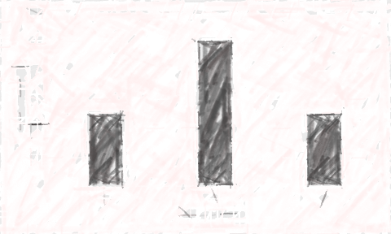
Probability Distribution is a statistical function which links or lists all the possible outcomes a random variable can take, in any random process, with its corresponding probability of occurrence.
Probability distribution by showing all possible values which a random variable can take along with the likelihood of those values.
Probability Distribution
0.5
Probability p(x)
0.25
0
1
2
No. of heads

Slide 14
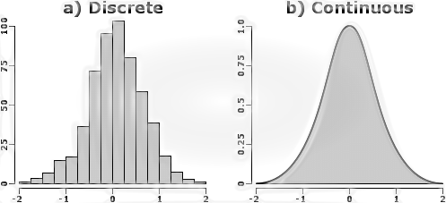
A random variable which can hold different set of values from the outcome of any random process. However, it lacks the capability to capture the probability of getting those different values.
So, probability distribution helps to create a clear picture of all the possible set of values with their respective probability of occurrence in any random process.
.
Why do we need Probability Distribution?

Slide 15
Expected value is the average value of a random variable over a large number of experiments.
In other words the expected value of a random variable is the weighted average of all possible values of the variable. The weight here means the probability of the random variable taking a specific value.
Expected Value
games
You flip the fair coin. Every time you get heads, you lose ₹1, and every time you get tails, you gain ₹1.
You flip the fair coin. Every time you get heads, you lose ₹1, and every time you get tails, you gain ₹2.
You flip the fair coin. Every time you get heads, you lose ₹1, and every time you get tails, you gain ₹1. Additionally, there is a ₹0.01 fee for every flip regardless of the outcome.

Slide 16
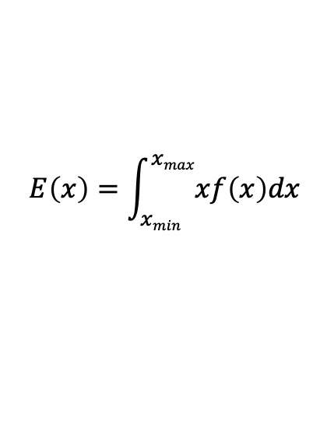
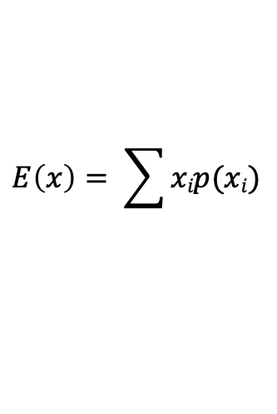
Expected Value
formula
discrete
$$E\left(x\right)= \sum{xip(xi)}$$
continuous
$$E\left(x\right)=\int_{xmin}^{xmax}{xf\left(x\right)dx}$$

Slide 17
Central Limit Theorem states that average of your sufficient sample means will be approximately equal to the population mean.
As you increase the number of samples, the plot will start to look a lot more like a normal distribution (where the data is symmetric about the mean and data near the mean are more frequent in occurrence than data far from the mean)
The average of sample means will approximately be equal to the population mean
The best part is that the above phenomenon holds true irrespective of the data distribution of the original population(which can be normal/skewed/uniform or any other distribution ).
The power of this concept is that we can even expand our original problem to a much larger context - - predicting which party will get a majority in an election, to calculating monthly debts of families living in different regions.
Central limit theorem

Slide 18
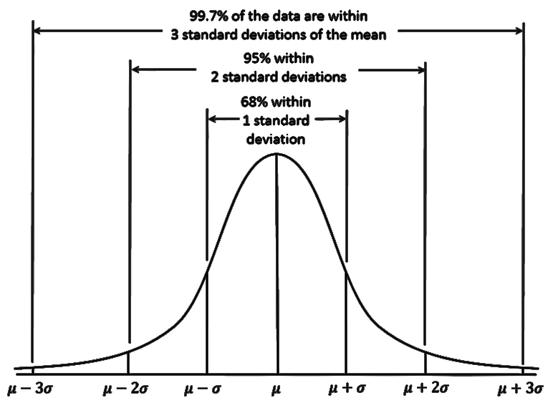
Standard deviation tells you how spread out the data is. It is a measure of how far each observed value is from the mean.
Standard Deviation
Standard Error
The standard error tells you how accurate the mean of any given sample from that population is likely to be compared to the true population mean. When the standard error increases, i.e. the means are more spread out, it becomes more likely that any given mean is an inaccurate representation of the true population mean.

Slide 19


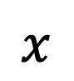
Sample vs population
We want to know about these
We have these to work with
sample
Random Selection
Interference from
parameter
μ
statistic
$$x$$
Population mean
Sample mean

Slide 20

Sampling bias – Case study 1
Dewey defeatus Truman - The most famous wrong call in electoral history
In the 1948 election season, Thomas Dewey faced off against incumbent Harry Truman for the presidency, running on the Republican and Democratic ticket, respectively.
The Chicago Daily Tribune, a Republican-leaning paper at the time, ran a poll forecasting the outcome of the election, with a decisive win for Dewey on November 6th. The night before the election was called, the Tribune went to press with the now-infamous headline: DEWEY DEFEATS TRUMAN.
Of course, that isn’t what happened. President Truman was elected with a comfortable margin of 49.6 percent of the popular vote to Dewey’s 45.1 percent. In the Electoral College, Truman won 303–189. At the end of the day, the Tribune’s polling predictions were off dramatically.

Slide 21

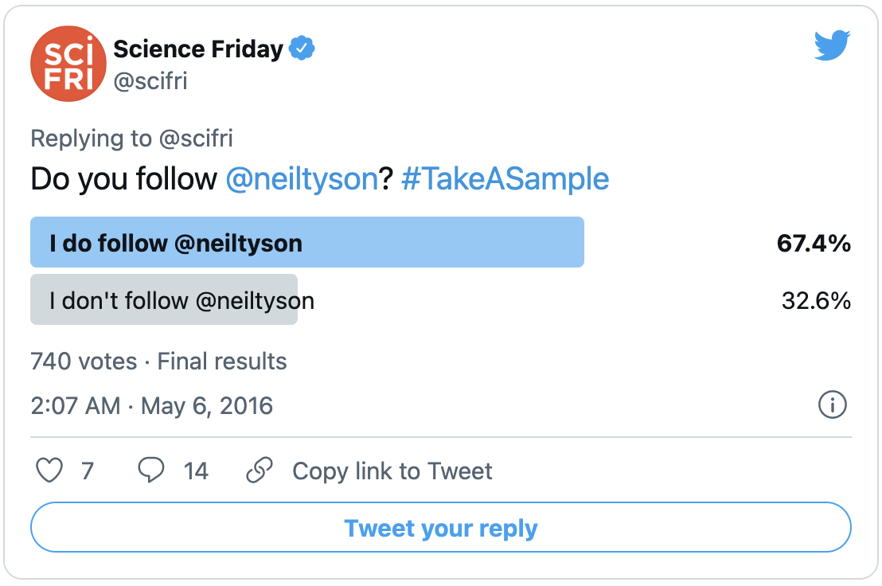

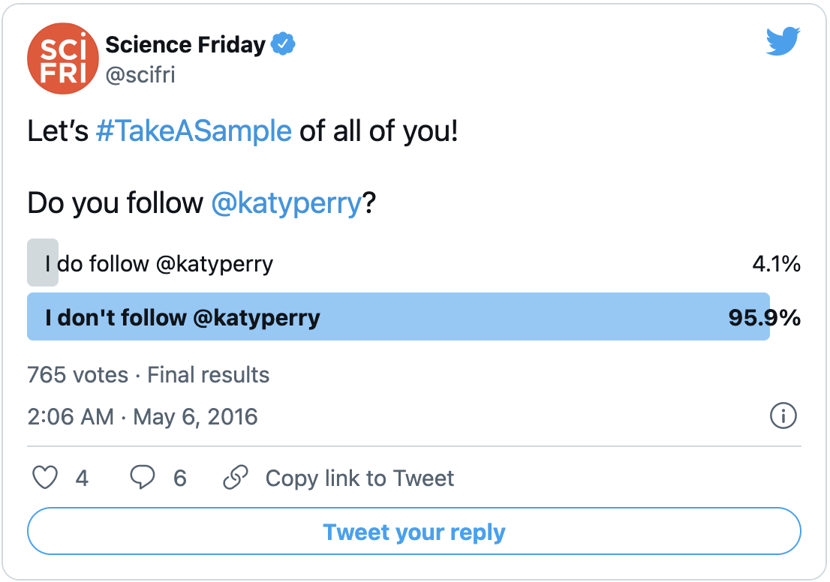
Sampling bias – Case study 2
When, how, and whom we polled may be fundamentally biased.
If the followers of Science Friday are an “unbiased” sample of the Twitter population, can we claim Neil Tyson is more popular than Katy Perry?

Slide 22

Sampling bias – Case study 3
Amazon ”machine learning” tool did not like women.
That is because Amazon’s computer models were trained to vet applicants by observing patterns in resumes submitted to the company over a 10-year period. Most came from men, a reflection of male dominance across the tech industry.

Slide 23
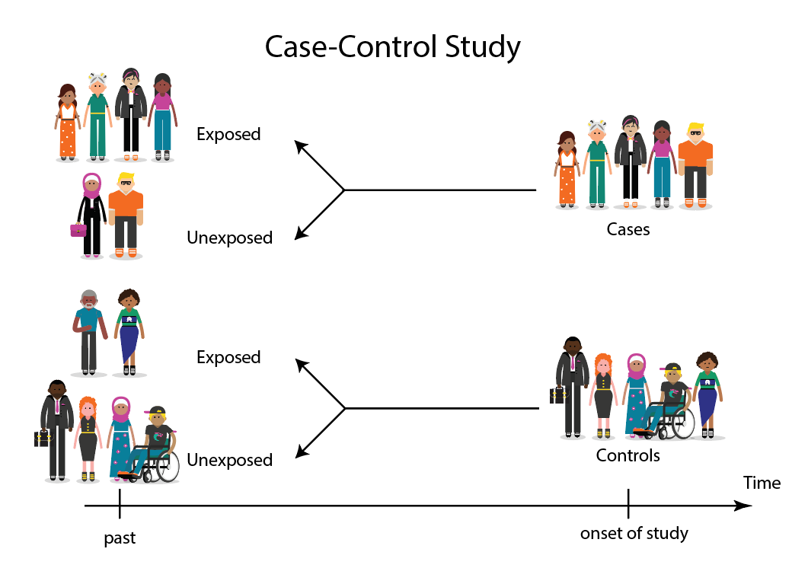
Sampling bias – Case study 4
Selection biased in “Case controlled Studies”
In a case-control study selection bias occurs when subjects for the "control" group are not truly representative of the population that produced the cases. Remember that in a case-control study the controls are used to estimate the exposure distribution (i.e., the proportion having the exposure) in the population from which the cases arose. The exposure distribution in cases is then compared to the exposure distribution in the controls in order to compute the odds ratio as a measure of association.

Slide 24
Sampling Bias Examples
Sampling from specific area – certain cities, particular subsection of population
Self-selection bias – when you have control over the selection of subject from the population
Exclusion bias – excluding groups from the population while selecting sample
Healthy user bias – selecting healthier subjects from the population
Berkson’s fallacy – selecting unhealthier subjects from the population
Survivorship bias – selecting only surviving subjects

Slide 25
Sampling Risk
Size Bias:
One “particular” subgroup in a population is likely to be over-represented or under-represented due to its size
Incorrect Response Bias:
A major problem with surveys is that you can never be sure that the person is “actually” responding truthfully.
Non-Response Bias:
One of the biggest problems in survey is that most people just don’t want to be bothered taking the time to respond to a poll of any kind

Slide 26
Sampling Techniques
1. Simple Random Sampling
Manish Kumar Sinha
Ekta Garg
Krithishree V K
Shalini Ashish Nair
Dileep Kumar Gorajala
Rahul Ramteke
Asmita Moitra
Vishwas Bhale
Madhuri Sampathirao
Madhur Sharma
Srikant Hotta
Nagaraj Gotur
Sumedhah Chittibabu
Kesava Kumar Tammireddi
Milind Borude
Siva Sankar Yendluri
Anwar Sadiq
Durlabh Kumar Jha
What bias do you see in this population?
Manish Kumar Sinha
Krithishree V K
Shalini Ashish Nair
Dileep Kumar Gorajala
Rahul Ramteke
Madhur Sharma
Nagaraj Gotur
Sumedhah Chittibabu
Milind Borude
Random Selection

Slide 27
Sampling Techniques
2. Systemic Random Sampling
Manish Kumar Sinha
Ekta Garg
Krithishree V K
Shalini Ashish Nair
Dileep Kumar Gorajala
Rahul Ramteke
Asmita Moitra
Vishwas Bhale
Madhuri Sampathirao
Madhur Sharma
Srikant Hotta
Nagaraj Gotur
Sumedhah Chittibabu
Kesava Kumar Tammireddi
Milind Borude
Siva Sankar Yendluri
Anwar Sadiq
Durlabh Kumar Jha
What bias do you see in this population?
Krithishree V K
Rahul Ramteke
Madhuri Sampathirao
Nagaraj Gotur
Sumedhah Chittibabu
Milind Borude
Durlabh Kumar Jha
Every “n” (here 3) subject

Slide 28




Sampling Techniques
3. Stratified Random Sampling
Dividing population into groups with “similar” attributes

Slide 29


Sampling Techniques
4. Cluster Random Sampling
Class V A
Class V B
Class V C
Class V D
Class V E
Class V F
Each “cluster” is representative of the entire population

Slide 30
A hypothesis is an educated guess about something. A hypothesis should be testable, either by experiment or observation.
For example:
A new medicine that someone thinks might be better
A new way of working that increases productivity
A Fairness cream that can make you fair or not
Hypothesis testing in statistics is a way for you to test the results of a survey or experiment to see if you have meaningful results. You’re basically testing whether your results are valid by figuring out the odds that your results have happened by chance. If your results may have happened by chance, the experiment won’t be repeatable and so you can’t conclude if it is true.
Hypothesis testing

Slide 31
A statement in which no difference or effect is expected. If the null hypothesis is not rejected, no changes will be made.
The word “null” in this context means that it’s a commonly accepted fact that researchers to nullify. It doesn’t mean that the statement is null itself!
Null Hypothesis
Alternate Hypothesis
A statement that some difference or effect is expected. Accepting the alternative hypothesis will lead to changes in opinions or actions. It is the opposite of the null hypothesis.

Slide 32

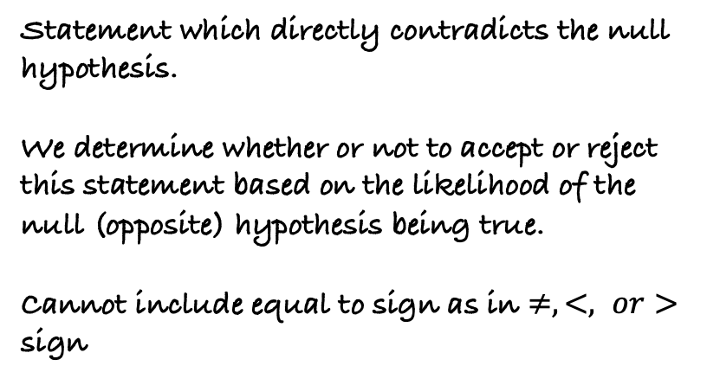
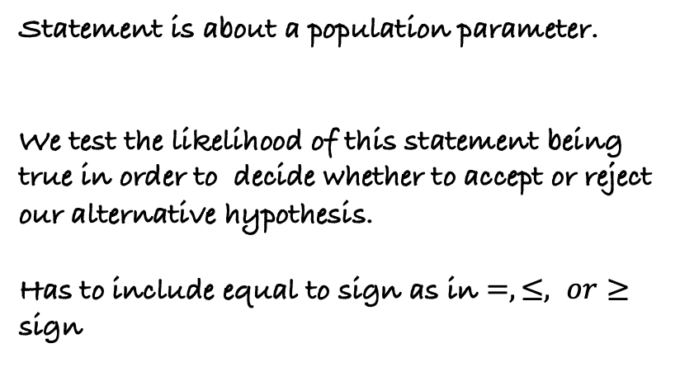
Null Hypothesis
Alternate Hypothesis
Statement is about a population parameter.
We test the likelihood of this statement being true in order to decide whether to accept or reject our alternative hypothesis.
Has to include equal to sign as in $=, ≤, or≥$ sign
Statement which directly contradicts the null hypothesis.
We determine whether or not to accept or reject this statement based on the likelihood of the null (opposite) hypothesis being true.
Cannot include equal to sign as in $≠, <, or>$ sign

Slide 33
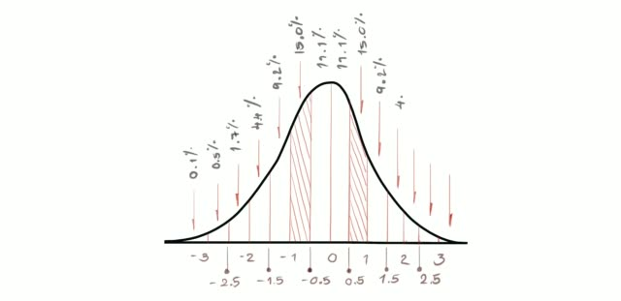
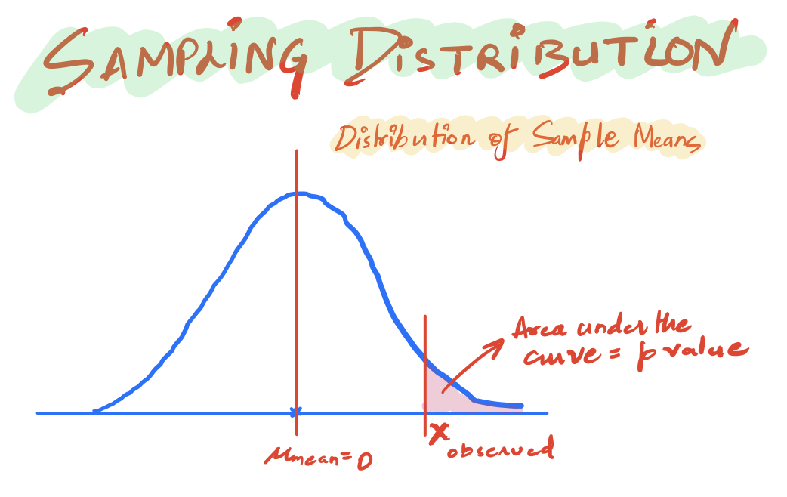
P-value
If we pick any random value from this distribution - the probability that we will pick values close to the mean is highest as it has the highest peak (due to high occurrence values in that region).
We can clearly see that if we move away from the peak, the occurrence of the values decreases rapidly and so does the corresponding probability, towards a very small value close to zero.

Slide 34

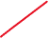


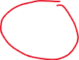
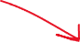
A p-value is the probability that random chance generated the data, or something else that is equal or rarer.

Slide 35
P-value
p-value corresponding to the red point tells us about the ‘total likelihood’ of getting any value to the right-hand side of the red point, when the values are picked randomly from the population distribution.

Slide 36
142 cm
169 cm
Distribution of height measurement of Brazilian women between 15 and 49 years old taken in 1996.
Source – Height of nations: A Socioeconomic Analysis of Cohort Differences and Patterns among Women in 54 Low-to-Middle Income Countries (Subramanian, Ozaltin and Finlay (2011))

Slide 37

this area indicates the probability that any Brazilian woman selected at random will be within the range of possible vales
142 cm
169 cm
Distribution of height measurement of Brazilian women between 15 and 49 years old taken in 1996.
Source – Height of nations: A Socioeconomic Analysis of Cohort Differences and Patterns among Women in 54 Low-to-Middle Income Countries (Subramanian, Ozaltin and Finlay (2011))

Slide 38
This implies that 95% of the Brazilian women were between 142 cm and 169 cm tall.
95% of the area under the curve is between 142 cm and 169 cm
Which means – there is 95% probability that each time we measure a Brazilian woman their height would be between 142 cm and 162 cm
142 cm
169 cm
Distribution of height measurement of Brazilian women between 15 and 49 years old taken in 1996.
Source – Height of nations: A Socioeconomic Analysis of Cohort Differences and Patterns among Women in 54 Low-to-Middle Income Countries (Subramanian, Ozaltin and Finlay (2011))

Slide 39
2.5% chance that the height would be less than 142 cm
2.5% chance that the height would be greater than 169 cm
142 cm
169 cm
Distribution of height measurement of Brazilian women between 15 and 49 years old taken in 1996.
Source – Height of nations: A Socioeconomic Analysis of Cohort Differences and Patterns among Women in 54 Low-to-Middle Income Countries (Subramanian, Ozaltin and Finlay (2011))

Slide 40
If a sample mean has p-value less than 0.25%, we reject the null hypothesis, and say that the mean came from another population, and average height is 142 cm.
142 cm
169 cm
Distribution of height measurement of Brazilian women between 15 and 49 years old taken in 1996.
Source – Height of nations: A Socioeconomic Analysis of Cohort Differences and Patterns among Women in 54 Low-to-Middle Income Countries (Subramanian, Ozaltin and Finlay (2011))

Slide 41

This purple-colored distribution will do a better job for us to draw inference about the population.
142 cm
169 cm
Distribution of height measurement of Brazilian women between 15 and 49 years old taken in 1996.
Source – Height of nations: A Socioeconomic Analysis of Cohort Differences and Patterns among Women in 54 Low-to-Middle Income Countries (Subramanian, Ozaltin and Finlay (2011))

Slide 42
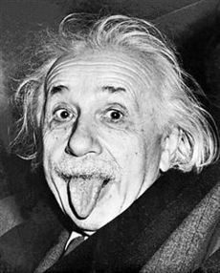
P-value does not hold any value by itself.
A large p-value implies that sample scores are more aligned or similar to the population score.

Slide 43

Author - Amit Pandey
Email - amitpandeylearn@gmail.com
LinkedIn - https://www.linkedin.com/in/amitpandeyprofile/

